Slide 1
24. Apache Commons CLI

Slide 2
Apache commons CLI
Open source library to make your programs to support various formats of CLI options.
See: https://commons.apache.org/proper/commons-cli/

Slide 3
Import Commons CLI into Eclipse via Gradle
Check this slides
https://docs.google.com/presentation/d/1BOYj8k11fnirpC5DfFGvvHeHyJ11b7_wpSnRQ2cXtkU/edit#slide=id.p
Check this example out
https://github.com/lifove/CLIExample
Runner.java
https://github.com/lifove/CLIExample/blob/master/src/main/java/edu/handong/csee/java/examples/Runner.java

Slide 4
Steps to create options
Definition Stage
Parsing Stage
Interrogation Stage

Slide 5
Steps to create options
Definition Stage
Create an instance of Options class.
Need to import org.apache.commons.cli.Options;
Options options = new Options();
Add each option in the options instance.
options.addOption(Option.builder("i").longOpt("inputdir") .desc("Set a directory path that contains input files") .hasArg() .argName("Directory path") .required() .build());

Slide 6
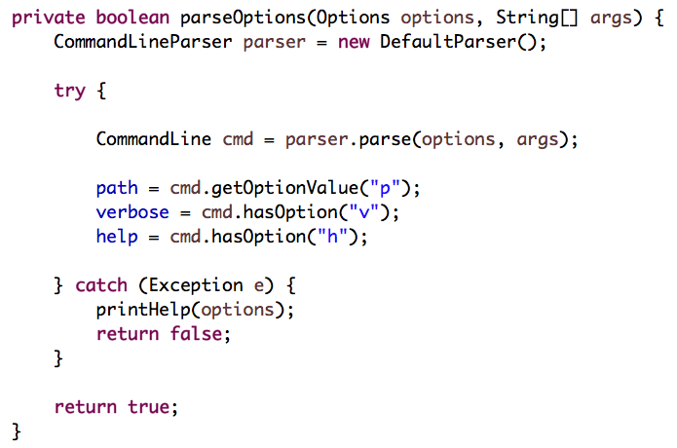
Steps to create options
Parsing Stage
Implement a logic that parse options typed by users in CLI.

Slide 7
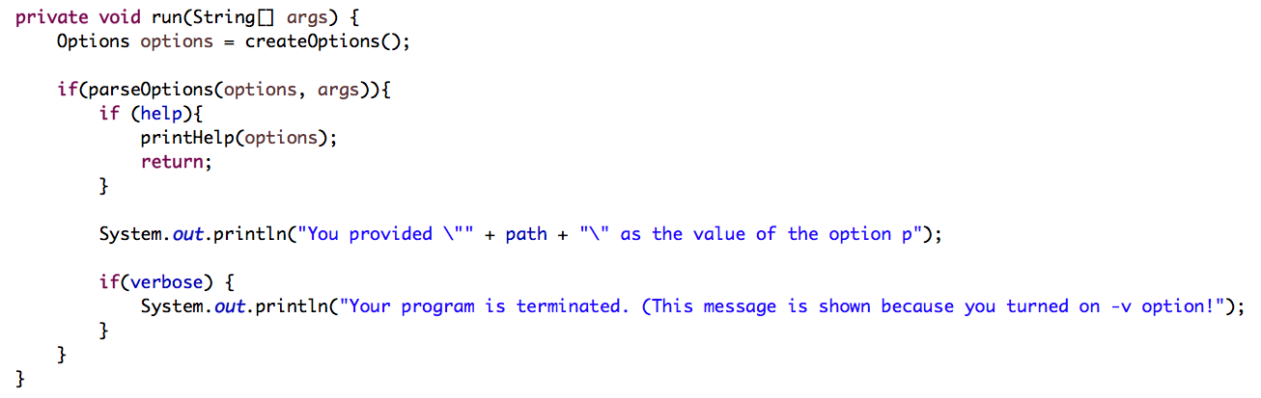
Steps to create options
Interrogate Stage
Use the options to implement your logic

Slide 8
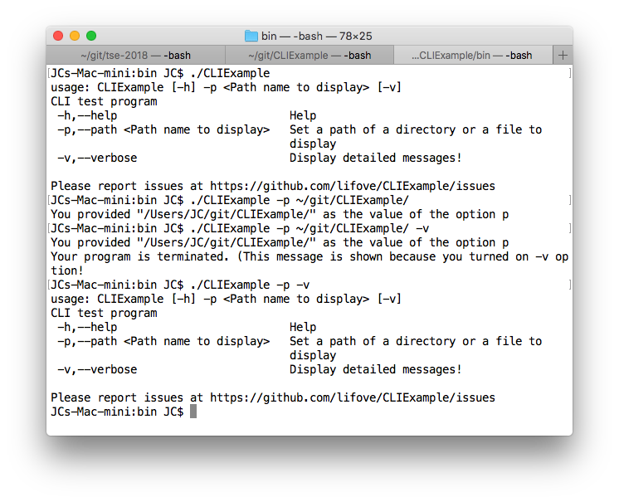
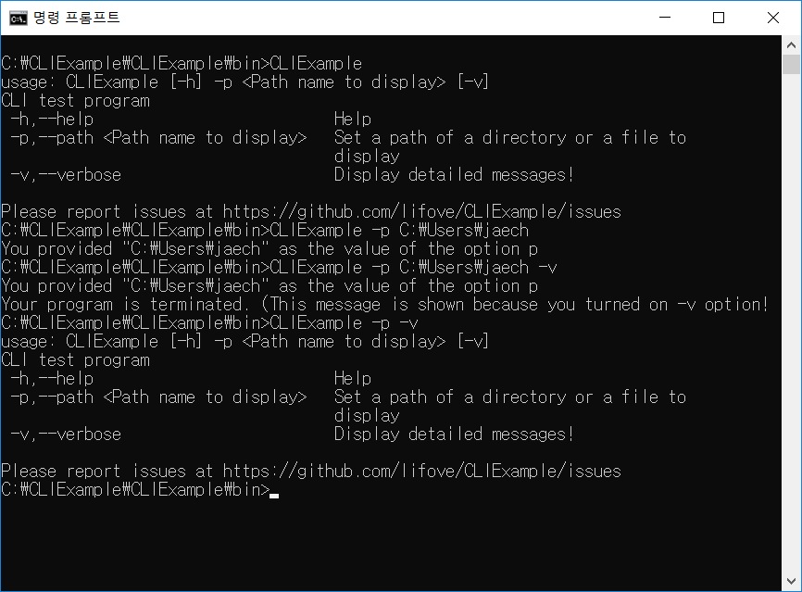
Execution results
Windows
Mac

